Slide 1

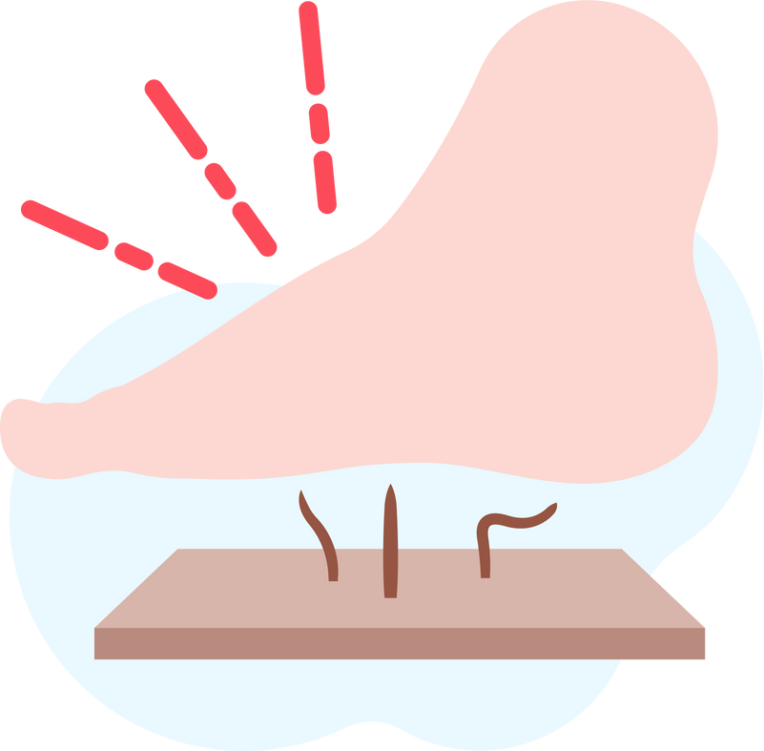
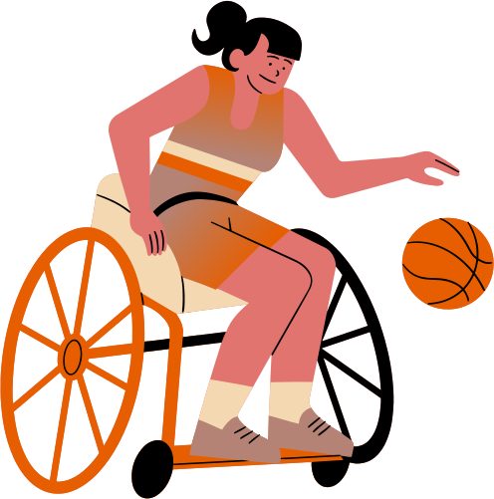
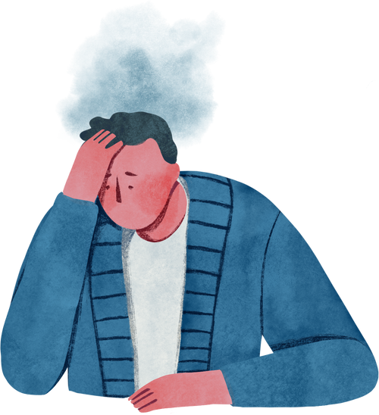

Lightning Talk 8:
Ethics and Professional Responsibility
PRESSURE SENSOR PATCH
sdmay25-12
Advisor: Santosh Pandey
Client: BAE Systems

Slide 2
Project Overview
Objective
Problem Statement
Core
Components
Develop a pressure sensor patch for Our project aims to create a pressure sensor patch that alerts users with reduced sensitivity to avoid prolonged pressure and prevent pressure sores
Individuals with nerve damage in their lower extremities are unaware of excessive pressure, risking injury. Our patch provides real-time monitoring to promote timely repositioning
  Load cell array for monitoring pressure.
  Microcontroller for data processing and Bluetooth connectivity.
  Mobile app for data visualization and alerts.

Slide 3
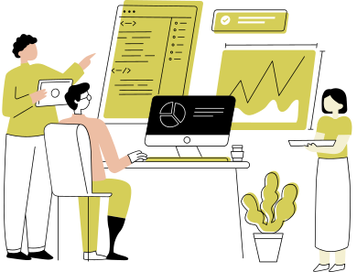
Professional Responsibility Area We Excel
Area: Health, Safety, and Well-being
Relevance:
Central to our project, as it focuses on minimizing risks to the health and well-being of users by alerting them to pressure sore risks.
Team’s Approach:
  Prioritizing user needs by designing an accessible app interface.
  Ensuring sensor accuracy through rigorous testing to provide reliable alerts.
Why This Upholds Ethical Standards:
  Proactively prevents health risks, aligning with our commitment to public welfare.
  Demonstrates responsibility in delivering a safe and effective product.

Slide 4
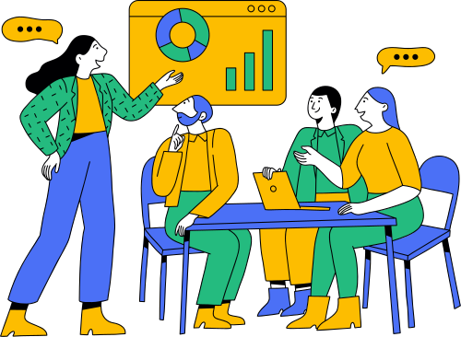
Professional Responsibility Area for Improvement
Area: Communication Honesty
Relevance:
Accurate and clear communication is critical when reporting sensor test results and app functionality to stakeholders.
Team’s Current Approach:
Sharing technical details during client meetings but occasionally lacking simplification for non-technical stakeholders.
Plan for Improvement:
  Create visual aids (e.g., graphs, charts) for technical data.
  Practice concise summaries of progress in plain language.
  Schedule additional feedback sessions with clients to ensure understanding.

Slide 5

Broader Context Area - Four Principles Chart
Principle | Relevance to Project
Stakeholders’ Well-being | Protects users from pressure sores, improving quality of life.
Environmental Sustainability | Using eco-friendly materials where possible for the device.
Respect for Rights | Ensuring data privacy and security within the app.
Honesty and Integrity | Delivering transparent progress updates to stakeholders.
Highlighted Principle:
Stakeholders’ Well-being
Integral to designing a product that prioritizes user safety and health.

Slide 6

Ethical Concerns
Potential Ethical Issues: | Team’s Plan:
Ensuring all user data is securely encrypted to protect privacy | Implement robust security protocols
Managing false alerts that could cause unnecessary concern or reliance | Test thoroughly to reduce false-positive rates

Slide 7
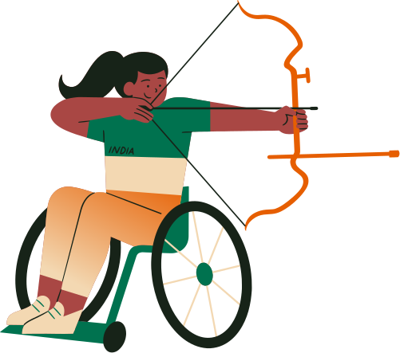


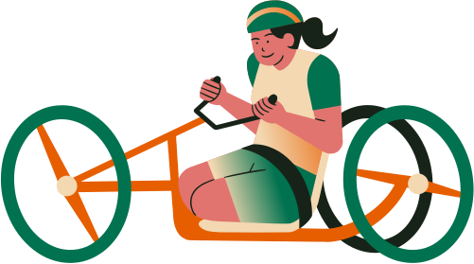
Virtue Discussion
Virtue Highlighted:
Empathy
Our project is driven by understanding and addressing the unique challenges faced by adaptive athletes with nerve damage.

Slide 8

Conclusion
We will reaffirm our commitment to upholding ethical and professional standards in all project aspects
&
Continuously improve and align our practice with these standards

